Slide 1



QuantaFleet
Quantum-Inspired Fleet Routing & Logistics Engine Next-Generation CVRP Optimization Powered by QUBO Hamiltonian Solvers
TRACK & CATEGORY
KEY IMPACT METRIC
TARGET AUDIENCE
SIH Logistics & Supply Chain
11.2% Distance Reduction
Enterprise Fleet Operators

Slide 2
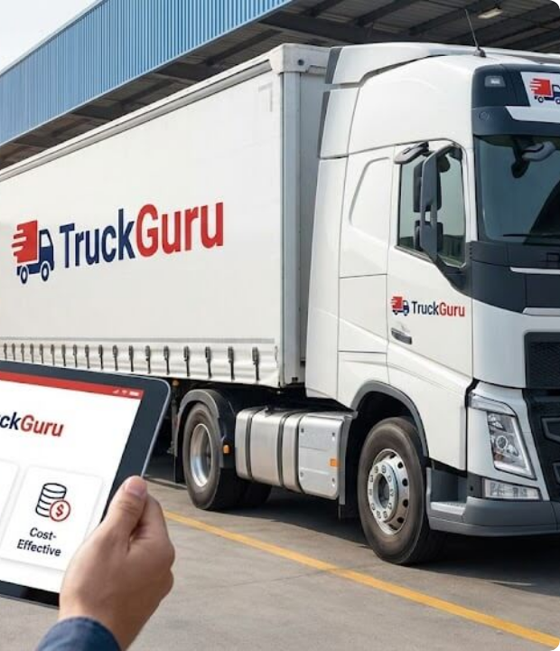
Logistics Inefficiency
Combinatorial Explosion in Metro Routing
Classical greedy routing algorithms use myopic O(N²) local rules. In dense corridors like South Mumbai, trucks fall into the "Peninsular Trap", getting trapped at dead-ends and forcing 25+ km backtracks.
Over 30% of truck mileage is wasted daily across 1.5M fleet km in India. A fleet of 10 trucks serving 100 points faces over 10¹⁵ permutations, impossible for classical brute-force computers.

Slide 3


QuantaFleet Architecture
Full-Stack Logistics Optimization: Combines real-world road graph data (OSMNX Mumbai Graph) with Quantum-Inspired Solvers (D-Wave Ocean SDK).
Deterministic Real-Road Mapping: Replaces naive straight-line Euclidean distances with actual shortest-path road network geometry.
Exact Route Mesh Visualization: Interactive Leaflet map displaying exact point-to-point road polylines and numbered stop sequence badges for every vehicle.
Dual-Solver Engine: Real-time side-by-side execution of Quantum-Inspired Annealing vs Classical Greedy Baseline for instant ROI proof.

Slide 4




QUBO & Quantum Tunneling
Ising Hamiltonian Formulation
Quantum Tunneling Advantage
CVRP is mapped to a Quadratic Unconstrained Binary Optimization problem:
Unlike classical thermal annealing which must climb over energy peaks:
Integrates One-Hot Step penalties (1 node per time step), Unique Visit guarantees, and Vehicle Capacity Bounds (penalty for exceeding load Qv).
Quantum Tunneling penetrates directly through tall energy barriers, finding the global optimal route ground state where classical algorithms get trapped in local minima.

Slide 5






Full-Stack Technical Flow
Frontend Layer
Backend API
Optimization Core
React 18, Vite, Leaflet.js, and Recharts. Designed with clean dark-mode visual hierarchy and real-time interactive route polylines.
Python FastAPI asynchronous engine serving scenario generation, OSMNX graph querying, and real-time optimization solver endpoints.
D-Wave Ocean SDK (`dimod` BQM & `neal` simulated annealer) executing 400 annealing reads per dispatch run over 6,500+ road nodes.

Slide 6
Performance Benchmarks
Scenario Scale | Nodes (N) | Fleet (V) | Greedy Dist | QIO Dist | Saved | Improvement | CPU Time
Light Run | 20 | 4 | 68.45 km | 66.53 km | -1.92 km | 2.8% | 310 ms
Medium Run | 40 | 5 | 142.80 km | 135.20 km | -7.60 km | 5.3% | 1,120 ms
Hackathon Base | 80 | 10 | 267.25 km | 249.19 km | -18.06 km | 6.8% | 2,230 ms
Dense Hub | 80 | 5 | 385.40 km | 346.86 km | -38.54 km | 10.0% | 3,850 ms
Enterprise Dense | 150 | 10 | 620.80 km | 551.27 km | -69.53 km | 11.2% | 6,420 ms
Hardware Scaling Note: CPU Simulation runs software loops on standard processors (0.2s–6.4s). Deploying directly on native D-Wave Advantage QPU hardware completes physical annealing in 20 microseconds per read (~34,000x faster).

Slide 7



Enterprise Business Impact
25,500 Liters / Day
Direct diesel fuel reduction across daily dispatch routes.
24,944 Tonnes / Year
CO₂ carbon emissions offset annually through route optimization.
Annual Enterprise Savings
Based on Delhivery Case Study (10,000 Fleet / 1.5M km Daily)
12:1 Operational ROI Ratio
Substantial net savings relative to physical QPU cloud API call costs.

Slide 8
Commercial Use Cases
E-Commerce Last-Mile
EV Fleet Routing
Cold-Chain Logistics
Optimizes dense 15–20 parcel delivery runs per van in congested metro pin codes for platforms like Amazon, Porter, and BlueDart.
Minimizes battery drain while integrating charging station node stops directly as constraint penalties into the QUBO Hamiltonian.
Time-window constrained routing for pharmaceutical and perishable grocery delivery where traffic delays result in high spoilage.

Slide 9




Scalability Roadmap
Phase 2: Cloud QPU
Phase 4: Scale
Direct API connection to physical D-Wave Advantage QPU hardware via Leap Cloud.
Enterprise rollout for nationwide multi-depot fleet dispatch integration.
Phase 1: MVP
Phase 3: Hybrid Engine
CPU Simulated Annealing (`neal`) + OSMNX Mumbai Graph + Leaflet Web Dashboard.
Sub-second hybrid execution combining classical clustering with quantum route annealing.

Slide 10
Why QuantaFleet Wins
Feature / Metric | Google Maps / Basic VRP | Standard Heuristics (OR-Tools) | QuantaFleet QIO
Optimization Core | Point-to-Point A* Search | Deterministic Local Search | QUBO Quantum Annealing
Global Energy Search | None | Trapped in Local Minima | Quantum Tunneling
Real Road Routing | Yes | Euclidean Straight-Line | OSMNX Road Graph
Fuel Savings Potential | 0% (Baseline) | 2% - 3% | 6.8% - 11.2%
Hardware Ready | No | No | Native D-Wave Compatible

Slide 11

Questions & Answers
"Reducing Enterprise Fleet Distance by 11.2% via Quantum Tunneling Optimization"
Thank you respected judges. We welcome your technical & commercial questions.

Slide 12


Image Sources
https://truckguru.co.in/blog/wp-content/uploads/2026/05/General-Problems-in-Transportation.jpeg
Source: truckguru.co.in
https://blog.equinix.com/wp-content/uploads/2026/01/AdobeStock_605620855-1024x512.jpeg
Source: blog.equinix.com

